Slide 1
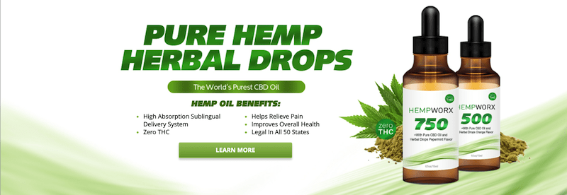
Clearing up cannabis:
CBD and Cannabinoids for Pain Management—An Emerging Frontier
Ryan Christensen DO
Michigan Osteopathic Association Spring Scientific Assembly
May 17,2019

Slide 2
CONFLICT OF INTEREST:
Ryan Christensen DO is a HempWorx Independent Affiliate
We wholesale HempWorx CBD through our primary care office for patients- Osteopathic Health Care Associates.

Slide 3
What do you need to know?
What is Hemp-Derived CBD? How is it different than marijuana?
Why the political controversy?
How is it used?
Is it legal in Michigan?
What are the known risks/benefits?
Research??
Would my patient benefit from it?
Notes:
If you are like me, I had a gross lack of knowledge. These were some of the questions I had and can hopefully answer with the rest of this presentation

Slide 4
CBD
Cannabinodiol
One of the active ingredients in cannabis, different than THC
No psychoactive effects
Low affinity to the CB1 and CB2 receptors
Enhances 5-HT, Glycine receptors, G couple receptors, effects intracellular calcium, antioxidant effects, anti-inflammatory effects, analgesic
“Charlotte's Web”
Orphan Drug status for treatment resistant childhood seizures (Epidiolex, GW Pharmaceuticals)
Notes:
Cannabidiol is not to be confused with THC, while both come from cannabis, THC is most active ingredient. Cannabidiol has no psychoactive effect, marijuana has high levels of THC
CB1: mostly in the brain, CB2 common in the immune system. CBD does not directly interact with these
Thought to have a major anti-inflammatory, analgesic, anti-nausea, anxiolytic, anti-epileptic. These have been the focus of research and possible clinical use.
Charlotte’s Web is marketed as a dietary supplement, produced in Colorado, high CBD to THC

Slide 5
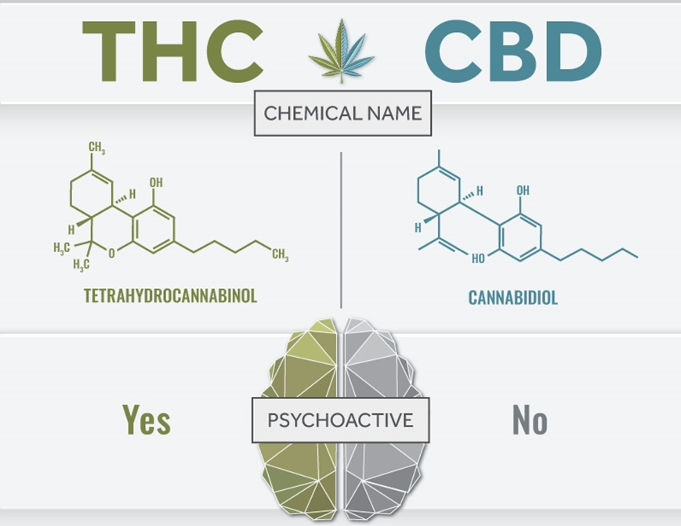
Notes:
Just in case any one wanted a chemistry lesson, this is all you get.
Remember that THC and CBD are different

Slide 7
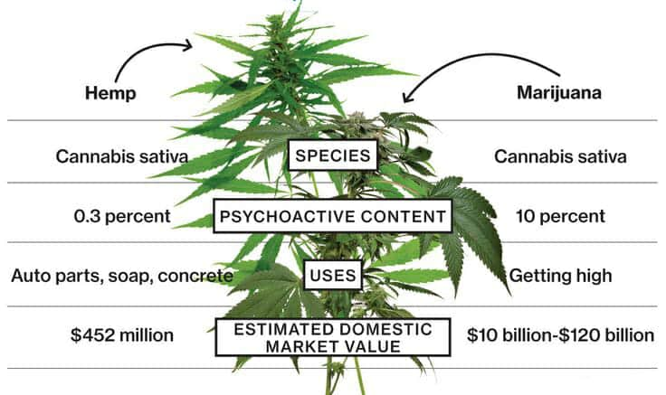
HEMP vs marijuana:
All CBD & THC is not the same!
THC up to 30%!
https://cbdorigin.com/hemp-vs-marijuana/

Slide 8
CBD Pharmacokinetics
Overall, not well known
Majority of data on animals
First pass metabolism (Extensive!)
Absorption depends on route (IV, oral, inhaled)
½ life of 9-32 hours
Low toxicity profile in studies (short term use)
Inhibitor of CYP450 (drug-drug interactions)
Notes:
So far research has not shown any adverse effects, but most studies are limited on length. Most studies are anecdotal, case reports, preclinical studies
Should remember that it is an inhibitor of CYP450

Slide 9
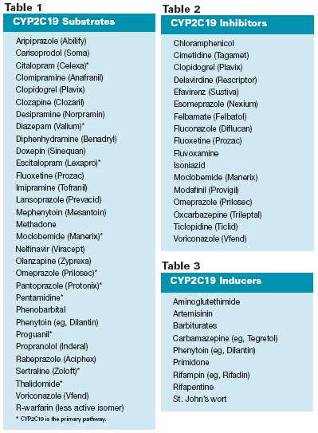
Watch for Drug Interactions!
CBD causes potent CYP2C19 inhibition!
https://www.ncbi.nlm.nih.gov/pubmed/23318708
CYP3A4 Genetics affects the sensitivity to CBD
http://profofpot.com/cyp3a4-genetics-cannabinoid-metabolism/
Pharmacytimes.com

Slide 10
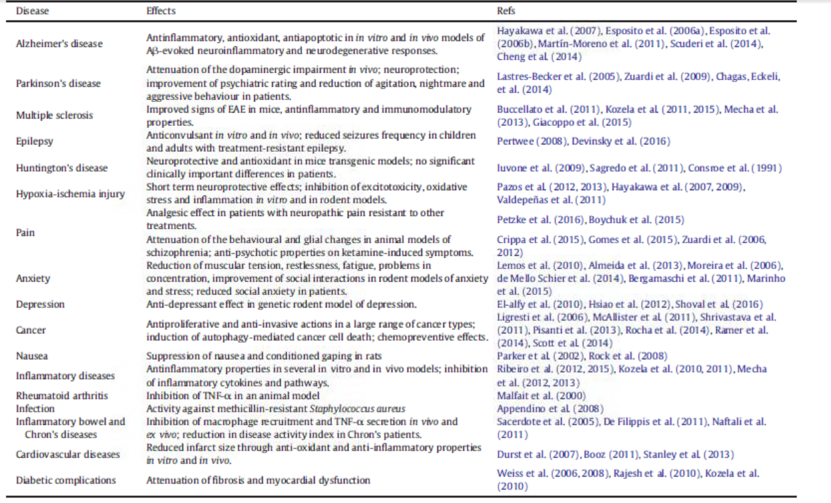
Proposed Uses (5)
Notes:
Going through multiple sources, these are some of the proposed uses for cannibidiol based on theoretical models and in vitro/vivo studies. We will be going through some research on this later. This had lead researches to theorize application toward inflammatory conditions and pain.

Slide 11
Possible Adverse Effects
Sedative
Psychological
Perception
Motor function
Dependence (9%)
Withdrawals
Stroke
Cerebral blood flow changes
Tachycardia, arrhythmia, MI
Carcinogens
Slowing of GI system
Reproduction
I DO NOT RECOMMEND ANY CANNABINOID or CBD PRODUCTS FOR PREGNANT MOTHERS.
Notes:
These are the adverse effects related to THC heavy products, when it comes to CBD the adverse effects are not as well characterized. Also much of what we know about side effects are from studies and case reports evaluating recreational users.
Psychological: euphoria, psychosis
Perception: distortion of sense of time, space, hallucinations
Motor function: ataxia, weakness, disequilibrium,
Dependence: with heavy use, (tobacoo is 32%)
Cerebral blood flow: increased with acute cannabis use, decreased with chronic use. Loose associations with stroke
Tachycardia with acute use and possible increase risk of with acute use.
Cannabis smoke may contain more harmful cytotoxic and mutagenic condensates. No studies have linked it with cancer
Suppresses ovulation and sperm counts

Slide 12
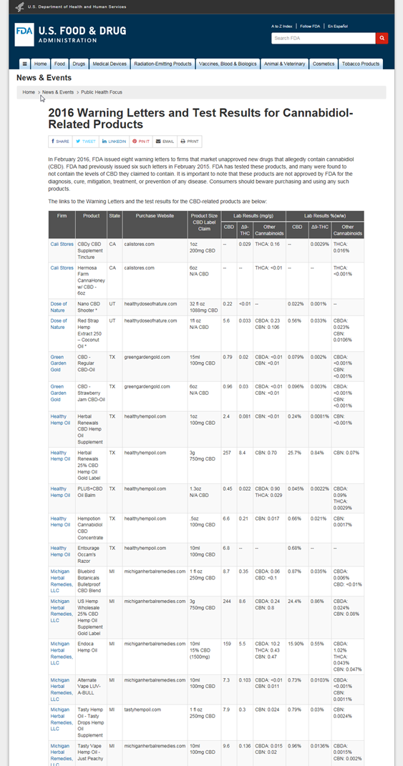
Are you getting safe CBD?
2016- FDA investigated products finding issues with what was contained in bottles. Included heavy metals, mold, and synthetic cannabinoids.
https://www.fda.gov/news-events/public-health-focus/warning-letters-and-test-results-cannabidiol-related-products
The Doctors- April 2019
https://www.youtube.com/watch?v=SKFAXqub__U
Notes:
Because CBD is not FDA regulated, there is no standard preparations. However, the FDA has tested certain products and put warnings letters out.

Slide 13
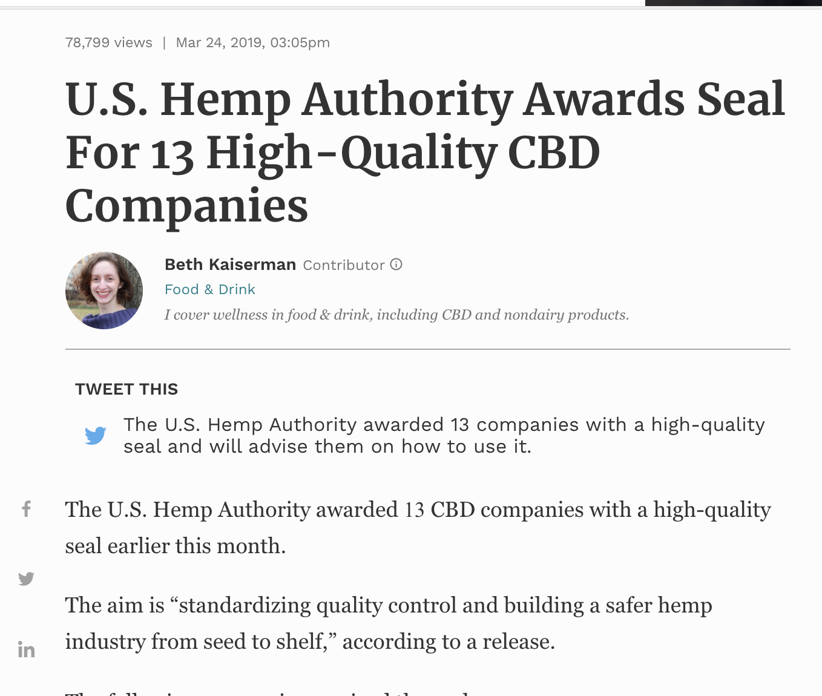
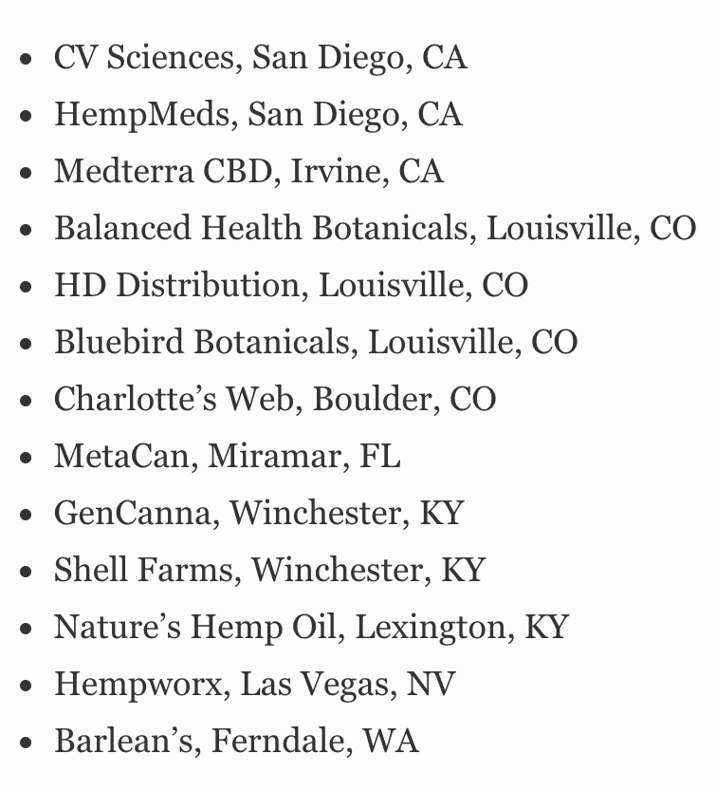
Where to ensure quality & safety?
US Hemp Authority Quality & Safety Certification:
https://www.ushempauthority.org/certified-companies
Notes:
From this search, it seems like there should be a big deal about CBD. To get a better understanding, we need to take a look back.

Slide 14
Historical Context: Cannabis
Medical use dates as far back as 1400-2000 BC
1611: Brought to Jamestown by settlers
1850: Listed in US Pharmacopeia
1913: US Dept of Agriculture grows domestic cannabis
1915 Sir William Osler, advocated for cannabis use in migraine
1930s: William Randolph Hearst plays role in denouncing marijuana
1936: “Reefer Madness”
Marijuana Tax Act of 1937
1960s: THC identified and synthesized, U of Mississippi becomes official grower under the Federal government
1970: Made a Schedule I substance, “No accepted Medical Use”
1973: Creation of the US Drug Enforcement Agency (DEA)
1976: Federal Court Rules Robert Randall’s Use of THC “Medical Necessity”
1978:-1991 Compassionate Use Program supplies patients with THC
1986: Reagan’s Anti-Drug Abuse Act (Mandatory Sentences)
1989: Bush’s New War on Drugs
1996: California becomes first state to legalize medical THC
2018: Farm Bill legalizes Industrial Hemp nationwide opening up domestic research on CBD and allows for the sale of Epidiolex in 2019 and beyond.
https://medicalmarijuana.procon.org/view.timeline.php?timelineID=000026
Notes:
A brief history lesson. Could really spend all day on this
Sanskrit and Hindi lit
1850: listed marijuana as treatment for numerous afflictions, including: neuralgia, tetanus, typhus, cholera, rabies, dysentery, alcoholism, opiate addiction, anthrax, leprosy, incontinence, gout, convulsive disorders, tonsillitis, insanity, excessive menstrual bleeding, and uterine bleeding, among others
Started growing in early 1900s, before that imported from India
In the early 1900s, US government started putting negative connotations to THC and linking it to criminal behavior, many think this was because the production of hemp was taking off and competing with lumbar/paper industries
Cult classic, intended to be a cautionary tale
1937:Negative propaganda from US around THC labeling it as a drug of abuse. Some think this was due to growing hemp industry. Marijuana Act was against the AMA’s position. Added high taxes and penalties
Same as LSD and heroine, more so because of lack of scientific evidence of benefits and risks, government concerned of growing marijuana economy
Research on Marijuana has remained illegal because of this. NIDA does contract with University of Mississippi– research-grade cannabis
There have been multiple attempts to have the DEA reschedule cannibus, but so far have not been successful.
http://medicalmarijuana.procon.org/view.timeline.php?timelineID=000026

Slide 15
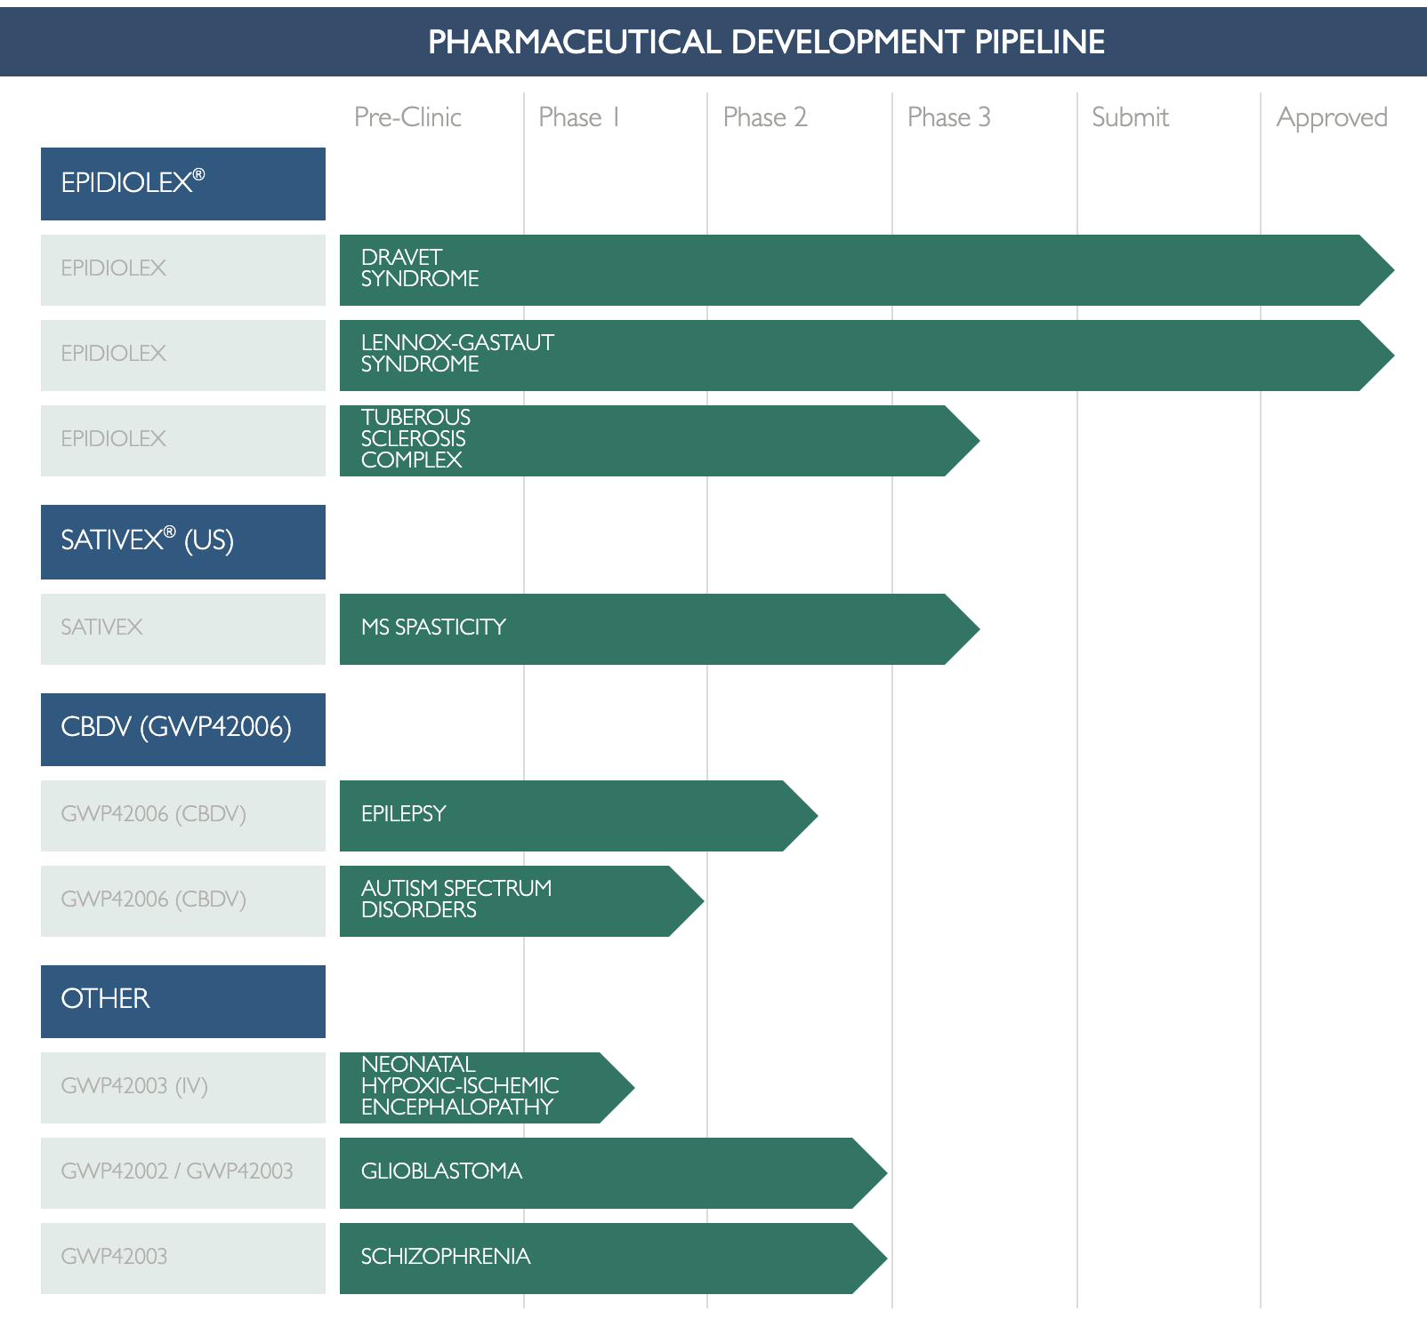
Epidiolex by GW Biosciences:
A new medication for epilepsy
New Pharmacologic Therapies
https://www.greenwichbiosciences.com/products-and-pipelines/pipeline-chart

Slide 16
Is Hemp-Sourced CBD Legal?
https://cbdorigin.com/is-cbd-legal/
Quick answer: Hemp-derived CBD is legal as long as it is produced within the regulations defined by the law.
In 2018, President Trump passed the Agricultural Improvement Act of 2018 (also known as the 2018 Farm Bill), which removed hemp as a Schedule I substance and reclassified it as an “agricultural commodity.”
A common misconception about the 2018 Farm Bill is that it legalized CBD regardless of if it was derived from hemp or marijuana. This is not true.
Based on the guidance of the DEA, CBD is a Schedule I substance and is illegal.
If, however, the CBD is derived from hemp and adheres to the following regulations set forth in the new farm bill, it is removed as a Schedule I substance and is legal:
The hemp must contain less than 0.3% THC
The hemp must adhere to the shared state-federal regulations
The hemp must be grown by a properly licensed grower
In addition, the 2018 Farm Bill also removed restrictions on the sale, transportation, and possession of hemp-derived CBD products and allowed for the transportation of hemp-derived CBD products across state lines as long as the products follow regulations defined above.
Notes:
California was first to legalize medical marijuana in 1996, since then 28 states of legalized medical marijuana .
Limited Marijuana includes CBD and those low in THC
In states were medical marijuana is legal, physicians don’t actually prescribe, rather they write a letter saying it is medical treatment

Slide 17
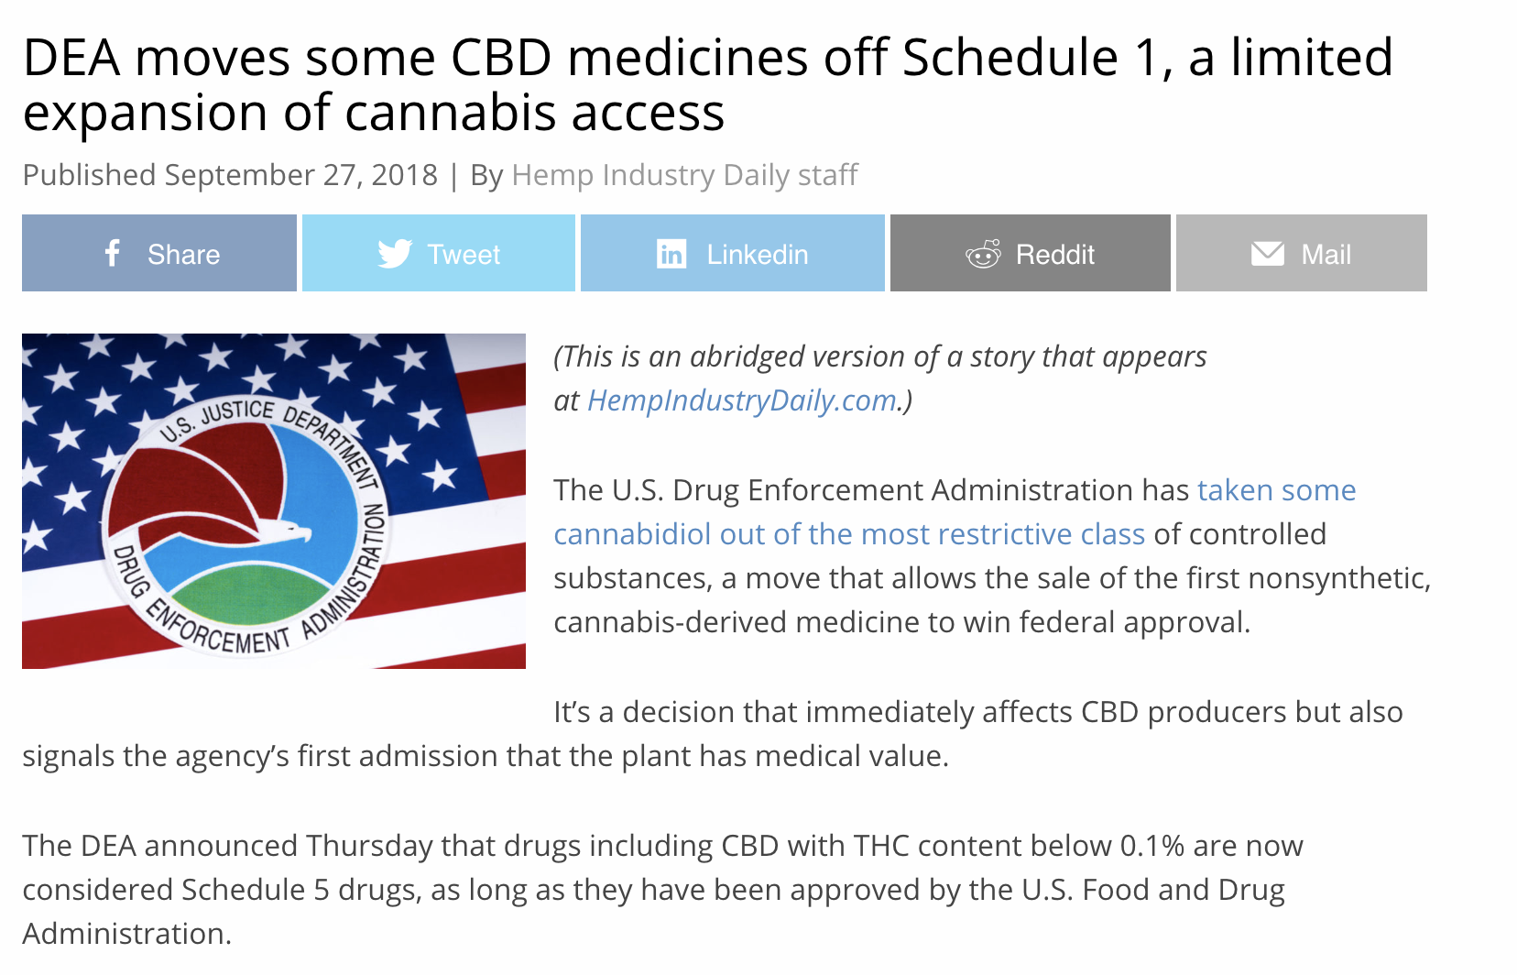
https://mjbizdaily.com/dea-moves-cbd-medicines-off-schedule-1-a-limited-expansion-of-cannabis-access/

Slide 18
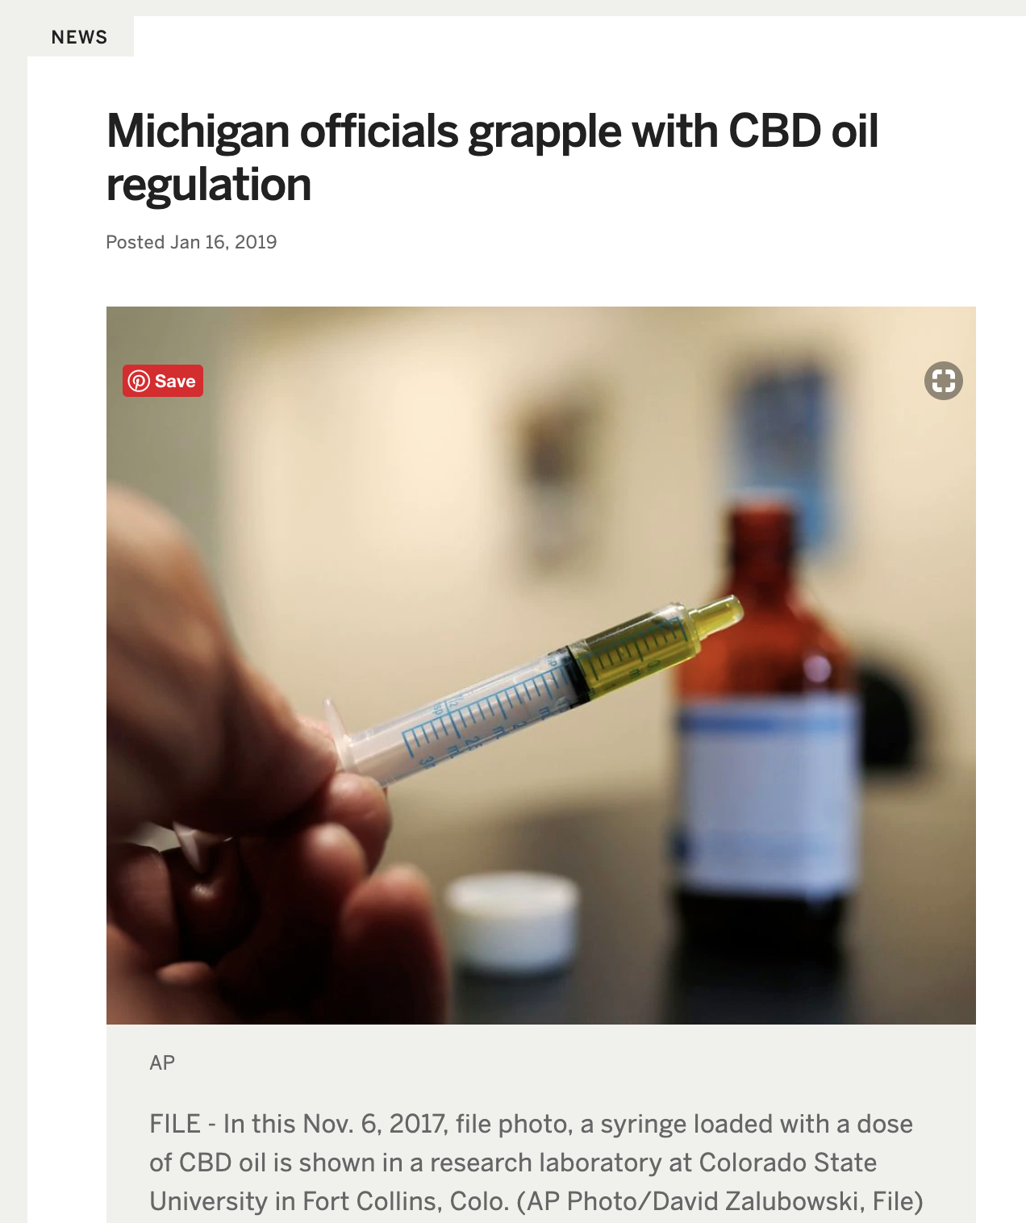
https://www.freep.com/story/news/marijuana/2019/03/03/michigan-marijuana-cbd/3022507002/
https://www.mlive.com/news/2019/01/michigan-officials-grapple-with-cbd-oil-regulation.html

Slide 19
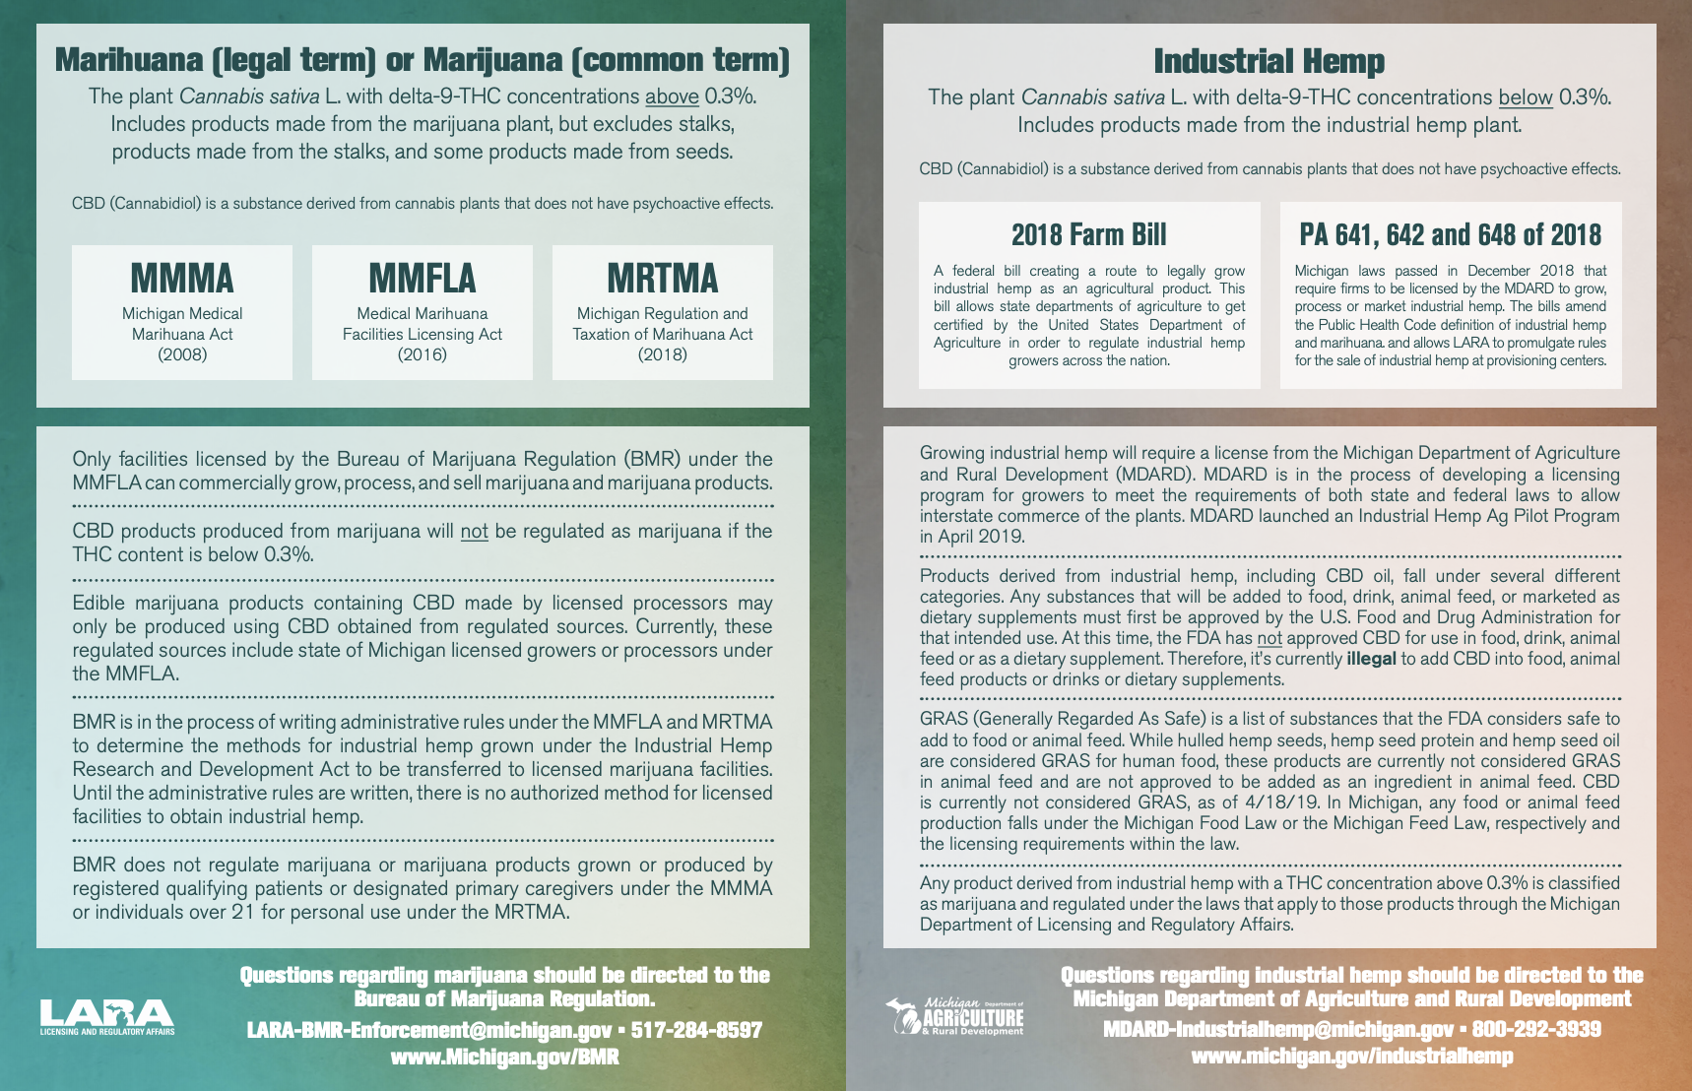
Michigan Offers Guidance on CBD and Industrial Hemp
March 29, 2019: The Bureau of Marijuana Regulation (BMR) and the Michigan Dept of Agriculture & Rural Development (MDARD) issued joint guidance regarding CBD (cannabidiol) and industrial hemp.
https://www.michigan.gov/lara/0,4601,7-154-89334_79571_78089-493382--,00.html

Slide 20
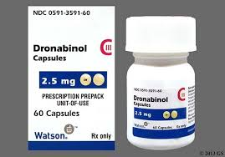
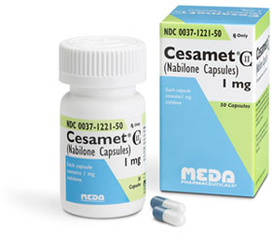
Pharmaceuticals
Currently 2 forms of synthetic THC is FDA approved in the US
Dronabilon (Marinol): cancer related nausea and vomiting, anorexia/weight loss in AIDS pts
C-III, 10 mg (60) $1351.30
Nabilone (Cesamet): cancer related nausea and vomiting
C-II, 1mg (50) $2252.05
Notes:
We do have 2 forms of synthetic marijuana. Which his interesting that the FDA approves when the federal govenerment has claimed that there are no medical uses of marijuana

Slide 21
Current Research
Barriers to research on THC due to Category I
Lack of high quality studies
Lack of long term follow-up
Anecdotal stories
You are trailblazers in this field. We are early!!!
17 Years for a new study to become accepted clinical practice
GW Pharmaceuticals: Epidiolex safety in Infants

Slide 22
Mix of Experimental and Clinical research
Cannabinoids suppress inflammatory and neuropathic pain by targeting α3glycine receptors. Journal of Experimental Medicine (13)
Short-Term Efficacy of CBD-Enriched Hemp Oil in Girls with Dysautonomic Syndrome after HPV (9)
CHANGING DAILY! Look to Europe and Canada for research that is further in the pipeline. Stay aware and we are likely to see changes as the pendulum swings in this debate & as science evolves. (Remember: Doctors used to not know to wash before surgery! Times change!)
Notes:
Earlier I mentioned some to the proposed used of CBD and cannibus. When you start looking the individual studies there is a mix of in vivo animal studies and also some strange cases…
Mice/rat model. CBD could be used to potentiate pain. Interesting
Completed in Italy, tolerated but no really no effects. Started with 21 females with severe somatoform/dysautonomic syndromes after HPV vaccine. 2 dropped out due to “iatrogenic adverse events, 2 stopped due to lack of improvement.

Slide 23
Cochrane Searches on CBD
Study | Type | Conclusions
Cannabinoids for Epilepsy 2014 (6) | Meta-analysis -4 RCTs | No reliable conclusions regarding efficacy, but no adverse effects reported for CBD in the short period
Cannabis and schizophrenia 2014 (9) | Meta-analysis -8 RCTs | Results limited and inconclusive. Insufficient to show that CBD has anti-psychotic effect
Cannabinoids for the treatment of dementia 2009 (7) | Meta-analysis - 1 RCTs met inclusion criteria | No evidence that CBD is effective More research needed
Effectiveness of cannabinoids in non cancer chronic pain (2) | Meta-analysis -13 RTCs | May provide analgesia in chronic neuropathic pain conditions refractory to other tx
Notes:
Was able to find some systemic reviews, however many of the studies do lump CBD with cannibus.
Assess efficacy and safety. One report was an abstract, one a letter to the editor. Low quality reports
23% of people with schizophrenia use cannabis. This review had 3 objectives
assess effects of psychological tx for cannabis reduction
Assess effects of of antipsychotics for cannabis reduction
Assess effects of CBD for symptom reduction
Looked at primary outcomes of clinical global impression of change and cognitive function. Had poorly presented results could not draw conclusions
Studies differed in type of cannabinoid used, time frame was 1-6 weeks. Side effects were greater in studies with smoked cannabis (sedation, anxiety, confusion, dizziness, concentration issues, decreased salivation and increased thirst. Gave a number needed to treat of 2-4 for 9 studies.

Slide 24
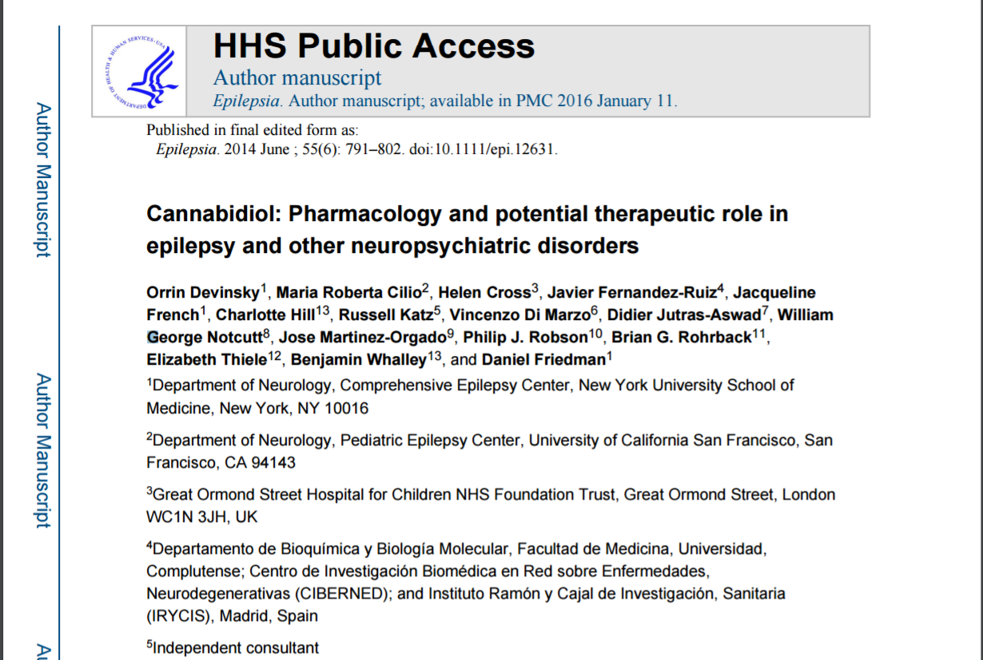
Notes:
Review of current research on CBD in epilepsy and neuropsychiatric medicine
Overall, CBD is promising as an anticonvulsant in acute animal models, but chronic is lacking
Does have neuroprotective and anti-inflammatory effects
Many anecdotal reports
Human Studies: multiple small studies, overall they are tolerated well however we are lacking long term studies. Also these studies have only been done in adults. Pharmacokinetics and toxicity of CBD is not know in children
Drug-Drug interactions: inhibitor of P450, inducer of CYP2B
More studies needed on whether CBD is treatment for DS and LGS

Slide 25
Medical Specialty Positions
AAFP: “Advocates that usage be based on high quality, patient-centered, evidence-based research. Advocates that the FDA change marijuana’s classification for the purpose of research. Opposes recreational use, supports decriminalization of possession and use“
AAP: opposes medical marijuana use in adolescents, supports changing to class II designation for research to be facilitated
AAN: supports efforts to conduct research, does not support legalization as further research needed
Notes:
When it comes to controversial and unclear topics, it is sometimes helpful to consult some of the medical group positions. Positions for FP, pediatrics and neurology were all pretty consistent in their standing
https://www.aan.com/uploadedFiles/Website_Library_Assets/Documents/6.Public_Policy/1.Stay_Informed/2.Position_Statements/3.PDFs_of_all_Position_Statements/Final%20Medical%20Marijuana%20Position%20Statement.pdf
https://www.aap.org/en-us/advocacy-and-policy/state-advocacy/Documents/Medical%20Marijuana.pdf#search=marijuana
http://www.aafp.org/about/policies/all/marijuana.html

Slide 26
Bottom line…
We need more research!
Check out AGONYFREECBD.COM for links to data sources and my compendium of data (in process!)
Hemp-Derived CBD products are legal to own, consume, and transport in Michigan and throughout the US. This can vary by state!
Direct your patients to one of the 13 brands certified by the US Hemp Authority to ensure quality and safety standards.
Be honest with patients about limitations & help guide them to good data and reputable products.
Start Low, Go Slow.

Slide 28
Ryan Christensen DO
dr.ryanc@gmail.com
agonyfreecbd.com
drryanc.com
Cell: 4069301627
Thank you!

Slide 29
References
Ammerman S, Ryan S, Adelman W. The Impact of Marijuana Policy on youth: clinical, Research, and Update. American Academy of Pediatrics. 2015. Online.
Baron E. Comprehensive Review of Medicinal Marijuana, Cannabinoids, and Therapeutic Implications in Medicine and Headache: What a Long strange Trip it’s been. Headache Currents. March 7, 2015.
Boychuk D, Goodard G, Mauro G, Orellana M. The effectiveness of cannabinoids in the management of chronic nonmalignant neuropathic pain: A systematic Review. Journal of Oral Facial Pain and Headache. 2015; 29: 7-14.
Consroe P, Laguna J, Allender J, Snider S, Stern L, Sandyk U, Kennedy U, Schram K. Controlled clinical trial of cannabidiol in Huntington's disease. Pharmacology, biochemistry, and behavior. 1991VL: 40NO: 3PG: 701-708PM: PUBMED 1839644PT:2/14651858.CD009270.pub3.
Devinsky O, Cilio M. R., Cross H., Fernandez-Ruiz J., French J., Hill C., … Friedman, D. (2014). Cannabidiol: Pharmacology and potential therapeutic role in epilepsy and other neuropsychiatric disorders. Epilepsia, 55(6), 791–802. http://doi.org/10.1111/epi.12631
Gloss D, Vickrey B. Cannabinoids for epilepsy. Cochrane Database of Systematic Reviews 2014, Issue 3. Art.No.: CD009270. DOI: 10.100
Krishnan S Cairns R, Howard R. Cannabinoids for the treatment of dementia. 2009. Cochran Dementia and Cognitive Improvement Group.
McCloughlin B., Pushpa-Rajah J, Gillies D, Rathbone J, Variend H, Kalakouti E, Kyprianou K. Cannabis and schizophrenia. 2014. Cochran Schizophrenia Group.
Naftali T, Mechoulam R, Gabay G, Stein A, Bronshtein M, Mari A, Konikoff FM. Cannabidiol treatment does not effect active crohn's disease. Gastroenterology. 2013. v144.
Palmieri B, Laurino C, Vadala M. Short-term efficacy of CBD-Enriched Hemp oil in girls with dysautonomic syndrome after HPV. IMAJ, 2017, vol 19: 79-84.
Pisanti S, Malfitano AM, Ciaglia E, Lamberti A, Ranieri R, Cuomo G, Abate M, Faggiana G, Proto MC, Fiore D, Laezza C, Bifulco M. Cannabidiol: State of the art and new challenges for therpauetic applications. Pharmcologcial Therapy. 2017.
ProCon.org (2017, January 30). Historial Timeline. Retreived from http://medicalmarijuana.procon.org/view.timeline.php?timelineID=000026
Wlety T, Luebke A, Gidal B. Cannabdiol: Promis and Pitfalls. Epielpsy Currents. 2014. Vol. 14, No. 5.
Xiong, W., Cui, T., Cheng, K., Yang, F., Chen, S.-R., Willenbring, D., … Zhang, L. (2012). Cannabinoids suppress inflammatory and neuropathic pain by targeting α3 glycine receptors. The Journal of Experimental Medicine, 209(6), 1121–1134.

